Slide 1
Session 2 Monday 20th November 2017
Starting school is an important time for children and
families.
Families play an important role in supporting
children to manage the transition to primary school.
With the support of your child’s early childhood
educator and school teacher and school community,
you can help them to cope with the new challenges
by developing their social, emotional and learning
skills. Supporting your child’s skills in these areas
contributes to their mental health and wellbeing.

Slide 2
Acknowledgement of Country
As we gather in prayer today, we acknowledge the Taungurung people
who are the Traditional Custodians of this land. We pay respect to the Elders of the Kulin Nation, both past and present, and extend that respect to other Aboriginals present. We acknowledge the owners of this land.
The Taungurung people are the first to awaken their talents and to care for others in this place. It is with their permission that we now use this land to celebrate God’s gifts to us.

Slide 3
Loving God, You are the giver of all we possess, the source of all of our blessings. We thank and praise you. Thank you for the gift of our children. Help us to set boundaries for them, and yet encourage them to explore. Give us the strength and courage to treat each day as a fresh start. May our children come to know you, the one true God, and Jesus Christ, whom you have sent.

Slide 4
May your Holy Spirit help them to grow in faith, hope, and love, so they may know peace, truth, and goodness. May their ears hear your voice. May their eyes see your presence in all things. May their lips proclaim your word. May their hearts be your dwelling place. May their hands do works of charity. May their feet walk in the way of Jesus Christ, your Son and our Lord. Amen.

Slide 5
Mary our Good Mother… Pray for Us
Our Lady of the Way… Pray for us
And may we always remember to… Pray for one another
Amen

Slide 6
PURPOSE OF THESE SESSIONS
To ask for God’s blessing on you and your family
To introduce some of our staff
To become familiar with Our Lady of the Way Primary School
To get to know other parents and families starting school in 2018
Your children will be meeting the 2018 Foundation Teachers,
making new friends and learning all about their new school.
The children will be ready for us at 10:45
Class groups are not yet confirmed

Slide 7
Teaching and Learning Focus…
When teaching and learning are “visible” – that is, when it is clear what teachers are teaching and what students are learning, student achievement increases.
Learner-centred
Positive, nurturing environment
Differentiated instruction catering for all individual needs
Use of structure, routines, challenging questioning to make students thinking more visible, which leads to greater student achievement

Slide 8
MRS JO GOODEN
TEACHING AND LEARNING -
LITERACY

Slide 9
LITERACY
LITERACY
During the literacy time in the classroom,
we will use a structure called The Daily 5.
At the beginning, this structure is put into place helping teach children
to be independent on literacy tasks. Once students are taught the behaviours of the tasks and build their stamina for independence, you will be able to work with individuals and small groups.

Slide 10
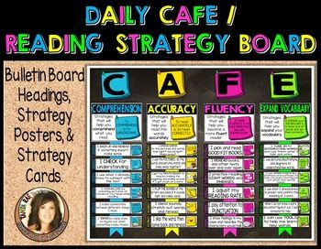
We will also use CAFE, a visual aid for organizing reading strategies the children will be learning to read books at their own level.
Once children are taught to build their stamina they will be engaged each day in these research-based meaningful tasks:
Read to self
Work on writing
Word Work
Listen to reading
Read to Someone

Slide 11
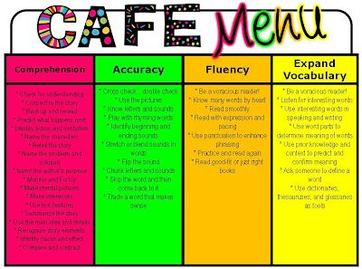
While the students are engaged in their literacy choices, the teacher will be teaching small groups and individuals, so everyone can get the just-in-time instruction they need to reach their full literacy potential.
CAFE is the organzation of the reading strategies taught during the Daily 5 time. CAFE is the acronym for the four major components of reading:
C for Comprehension
A for Accuracy
F for Fluency
E for Expanding Vocabulary

Slide 12
The focus on Smart Spelling is to
implement a weekly routine for teaching spelling
teach both intentionally and incidentally – at the point of need
differentiate spelling words…easily!!!
teach the most effective 4 spelling rules
understand the Prep – 6 scope and sequence
teach with a range of fun spelling activities

Slide 13
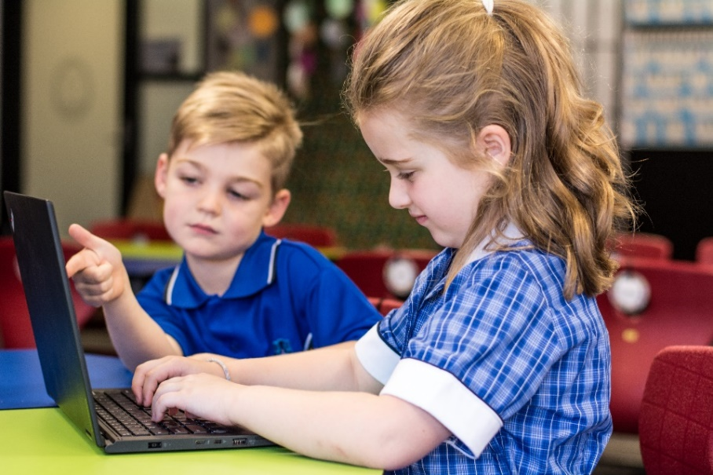
WRITING
FOUNDATION
When writing, students use familiar words and phrases and images to convey ideas. Their writing shows evidence of letter and sound knowledge, beginning writing behaviours and experimentation with capital letters and full stops. They correctly form all upper- and lower-case letters.
LEVEL 1
When writing, students provide details about ideas or events, and details about the participants in those events. They accurately spell words with regular spelling patterns and use their knowledge of blending and segmenting, and many simple and high-frequency words to write predictable words. They use capital letters and full stops appropriately.

Slide 15
MATHEMATICS
TYPICAL NUMERACY SESSION
Number sense:
Short, sharp number activity, previous learning,
engaging, mental comp.
Whole Class Focus:
Setting the context, explaining the task, lesson intention.
Group Activities / open ended investigation:
Explore, investigate, reinforce and / or extend mathematical understanding. Use different grouping models to suit the activity and show how the activity can be differentiated to suit students working at different levels.

Slide 16
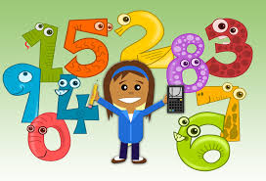
Whole Class reflection:
Reflect upon, make connections & articulate mathematical understanding. This can be done throughout the lesson with small groups as is required or at the conclusion of the lesson.
Teacher Summary:
Summarize the lesson and make explicit the mathematics learned. Where to from here?

Slide 18
LITURGY AND MISSION
Daily prayer at Our Lady of the Way
Class / School Mass – Dates to be
Weekly Liturgies of the Word – Whole School
Feast Day – 24th May
Mass at Our Lady of the Way Wallan – 9:15 a.m. second, third and fourth Sunday of each month
Community Prayer in St Patrick’s Church @ 9:00 each Friday – all welcome. This will include any assembly items

Slide 19
2018 – Classroom Structure
1 Prep Class – approximately 23 students
1 Year One Class – approximately 22 students
1 Multi Age Class – including Prep Children, Year Two children and Year 3 Children, maximum 20 students

Slide 20
SPECIALIST CLASSES
1 Hour Per Week
Performing Arts – Half Year (Mrs Annette Moore)
Visual Arts – Half Year (Mrs Annette Moore)
Language [French] – Whole Year (Mrs Sonia Cook)
Physical Education and Health – Whole Year (Mr Terry Cooney)

Slide 21
ST PATRICK’S SCHOOL RESOURCES
Library
The resources in the Library are St Patrick's resources.
We will have our own resources (books, computers etc) that the students can access from their classroom.
Buildings
All Physical spaces Library / Stadium / Netball Courts etc are available to us as long as St Patrick's are not using them at the time.
We will sit down as two schools and work out a timetable later in the year.

Slide 22
IMPORTANT DATES – TERM 1
Monday 29th January – Office Opens
Monday 29th – Wednesday 31st January – Staff Days
Thursday 1st February – First day of School
Wednesday 7th February – Prep Rest Day
Tuesday 13th February – Parent Teacher Meetings
Wednesday 14th February – Prep Rest Day
Wednesday 14th February – Ash Wednesday Liturgy
Sunday 18th February – Opening School Mass @ Our Lady of the Way Wallan, 9:15a.m.
Wednesday 21st February – Prep Rest Day

Slide 23
Wednesday 21st February – Parent Teacher Meetings
Wednesday 28th February – Prep Rest Day
Monday 12th March – Labour Day Holiday
Tuesday 13th March – School Photo Day
Thursday 15th March – Catholic Ed Week Mass
Monday 19th March – St Patrick’s Day Celebration
Sunday 25th March – Palm Sunday Mass at Our Lady of the Way Wallan, 9:15a.m.
Thursday 29th March – Holy Thursday Liturgy
Thursday 29th March – Term 1 Ends

